Slide 1
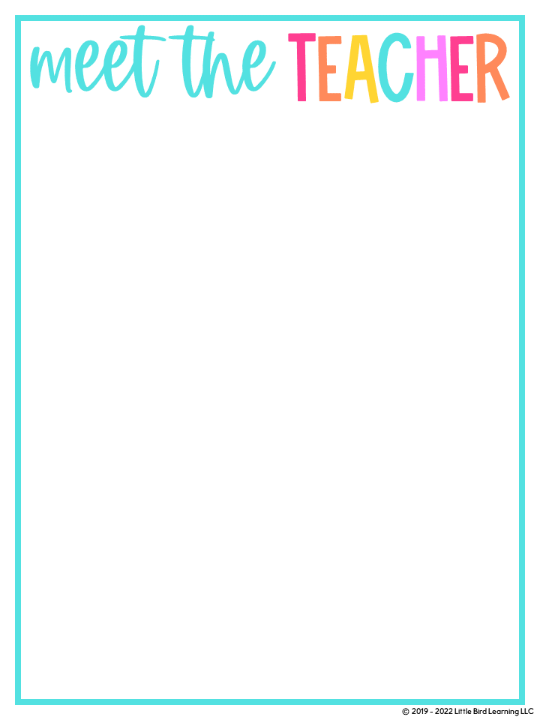


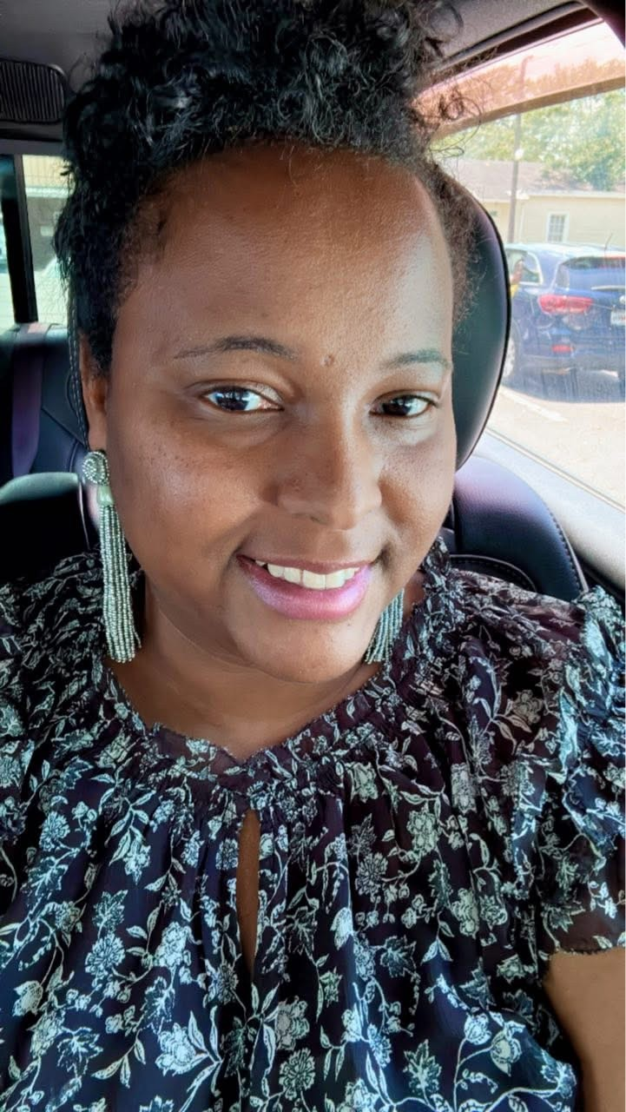





Editable Meet the Teacher Template (Color)
This is an EDITABLE version of the template used to create the sample letter. Customize this template for your class!
I’m Mrs. Fowler
This year awaits new adventures as we dive into Math & Science. My goal is to educate the whole child using technology, group discussions, and engaging real-world activities.
Color: Lavender/Purple
Book: The Bible
Candy: M&M’S with nuts, almond joy, and snickers.
Hobbies: Spending time with family, resting, and shopping.
I am married and we have a handsome nine year old son. Teaching is my passion as I educate the whole child one step at a time.
ClassDojo
Email:fowlesh3@boe.richmond.k12.ga.us
Phone: (706)796-4985

